Slide 1
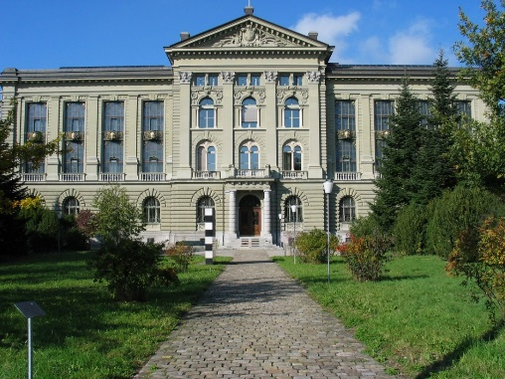
Linked Data – the Missing Link between Open Government Data and Archives
Dr. Krystyna Ohnesorge and Dr. Jean-Luc Cochard
Swiss Federal Archives SFA
DLM Forum Brighton Triennial & ARMA International European Conference in Brighton, 13-15.09.2017

Slide 2
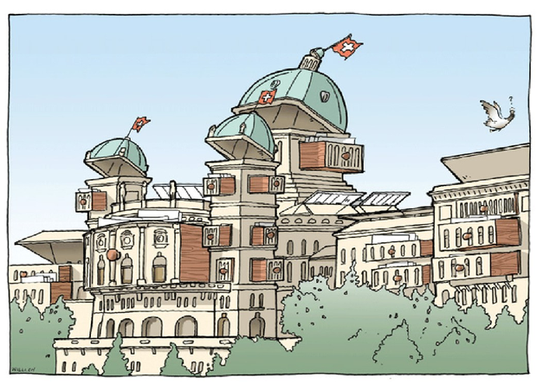
Open Data and Linked Data
New projects:
LD Platform
AIS Future

Slide 3
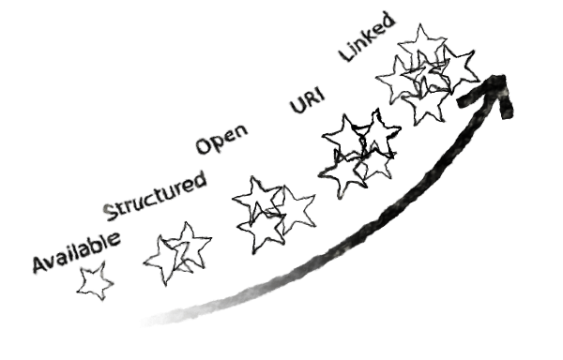
OGD as a Publication Channel

Slide 4
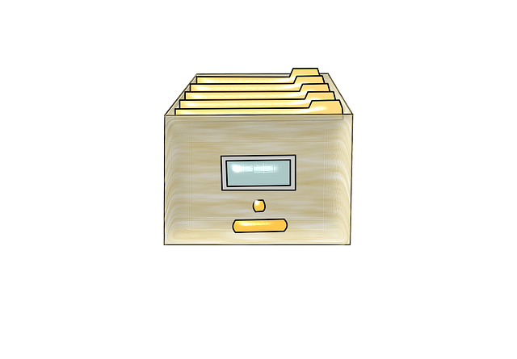
Linked Data Publication Features
Linked Data for Archival Catalogue
Linked Data for Publishing Data

Slide 5
Linked Data for Archival Catalogue (AIS-Future)
3rd-party app
3rd-party app
Archives network
3rd-party app
web-based AIS
3rd-party app
SPARQL queries
distributed catalogue

Slide 6
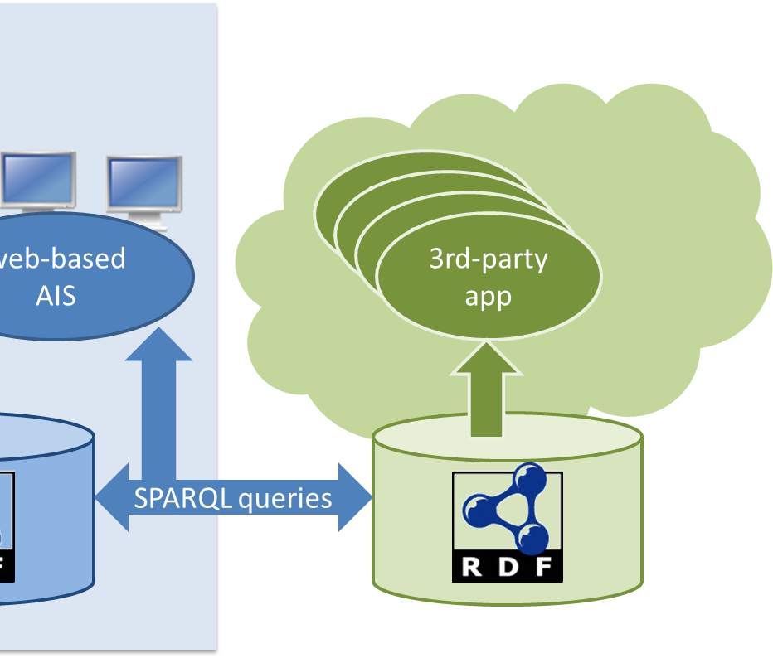
Linked Data for Publishing Data
Experimen- tation
LD-infrastructure
Datasets publication
Production
Central infrastructure for the public sector
Datasets harvesting and conversion
Operation
Best practices in publication
Supervision for definition of national ontologies
Data quality insurance

Slide 7
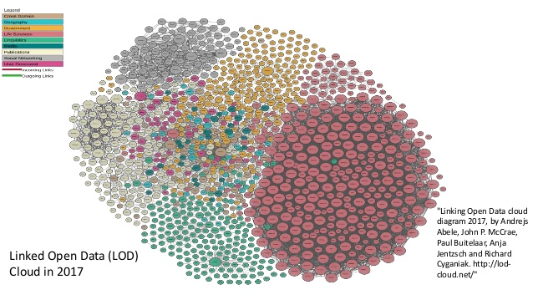
Linked Data for Preservation
Linked Data (=Web of Data) → web archiving
Data model of LD-datasets described in LD too – RDF is self-describing
Datasets can be dumped as text files
Linked Data is strongly tied to the web architecture (URIs dereferencing)
Publication of archived LD-datasets may reconnect to updated resources
What about the SPARQL-endpoint as presentation tool?
Where is the limit of a dataset to be ingested?

Slide 8
Preservation of Linked Data
Analysis
Prelida: Preservation of Linked Data
Diachron: Managing the Evolution and Preservation of the Data Web
Experimen-tation
Run R&D projects under the supervision of archival institutions
Operation
Define policies for data suppliers
Implement archived LD-datasets publication
LOD2: Creating Knowledge out of Interlinked Data
Implement LD-datasets ingestion
Implement LD-datasets preservation strategies

Slide 9
Conclusion
Linked Data in the Swiss Public Sector
Roadmap for Using Linked Data
Roadmap for Preserving LOGD

Slide 10
Thank you – Danke – Merci!
Contact and questions:
Information Preservation Division IPD
Swiss Federal Archives SFA
Jean-Luc.Cochard@bar.admin.ch
Krystyna.Ohnesorge@bar.admin.ch
www.bar.admin.ch
www.facebook.com/Bundesarchiv.Schweiz
www.twitter.com/CH_Bundesarchiv
www.youtube.com/bundesarchiv

