Slide 1
National Data Strategy
Digital Malta Strategy 2014 – 2020
Malta Libraries Act – Cap 511
Public Administration Act – Cap 497
National Archives Act – Cap 477
Data-Driven Public Administration
Civil Code – Cap 16
Re-Use of Public Sector Information Act – Cap 546
Public Registry Act – Cap 56
Notarial Profession and Notarial Archives Act – Cap 55

Slide 2
Document Life Cycle Management
Legal
Organisational
Document – Recorded data which can be treated as a unit of information
Semantic
Technology

Slide 3
Volatility
Risk Level / Register Status
Data Sharing / Traffic Lights System
Data Stewardship / Core Vocabulary
Classified / Unclassified Data

Slide 4
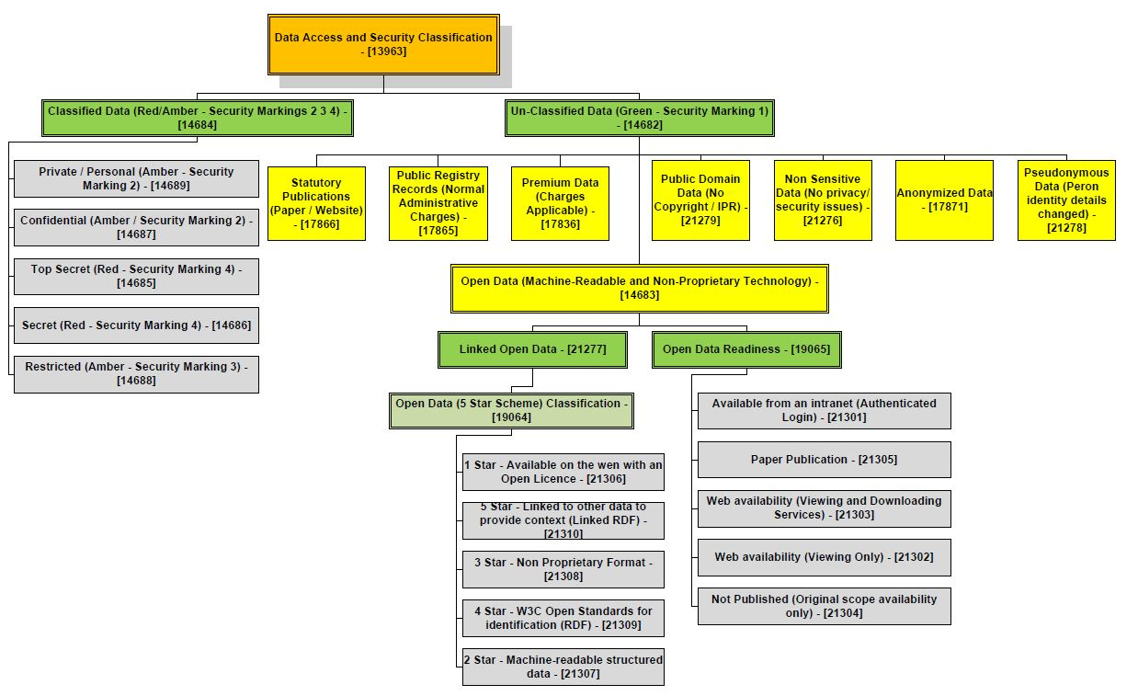

Slide 5
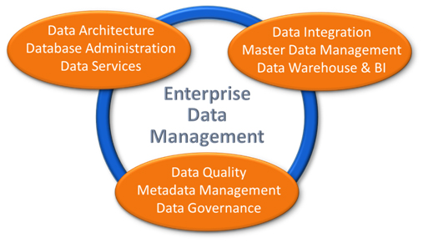
Enterprise Data Management
Open Data
Big Data
Free Flow of Data – Data Economy

Slide 6
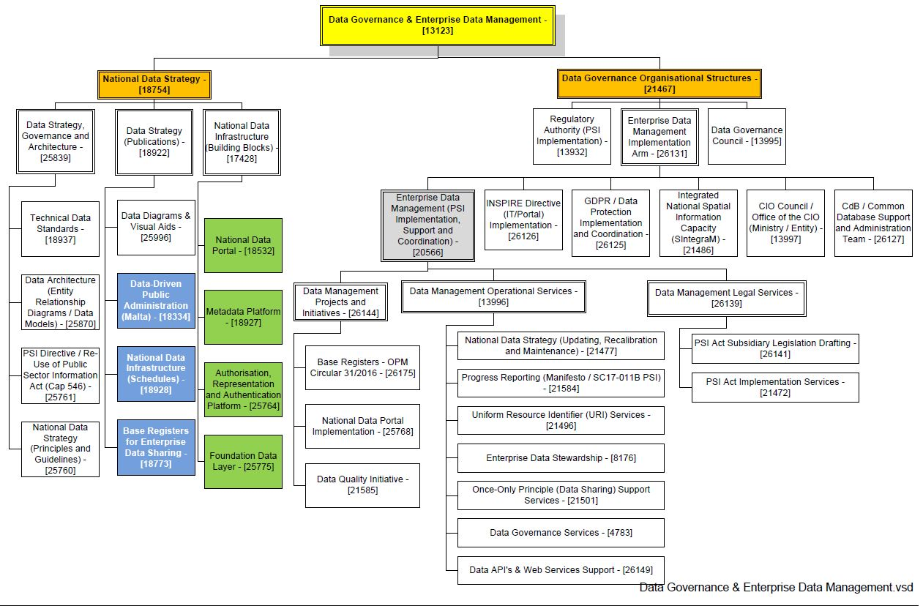

Slide 7
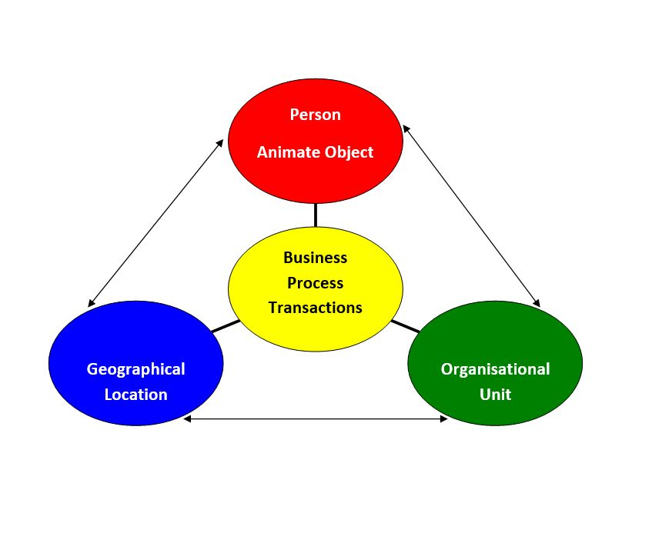
Data Stewardship Classification – 3 Pillar Approach

Slide 8
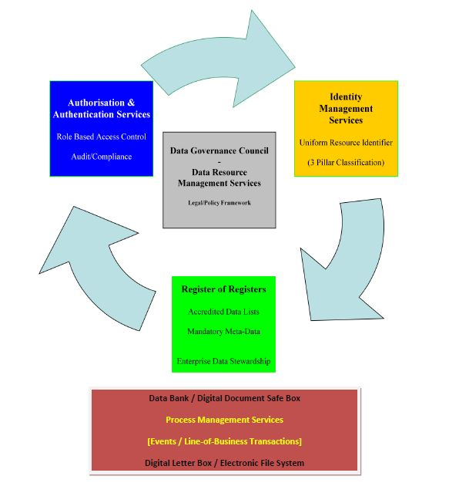
Integrated Public Administration

Slide 9
Principles & Guidelines
Holistic Approach and Central Oversight
Legal Basis and Data Ownership
Classification of Data
Master and Reference Data Management
Metadata and Content from Accredited Source Only
National Vocabularies for Semantic Interoperability
Common Identity Management Protocols
Role-Based Authorisation and User Managed Access
Base / Foundation Data Registers
Linked Official Registers
Digital by Default
Open by Default
Linked Official Registers

Slide 10
Main Features / Innovation / Paradigm Shift
Quod non est in Registro non est in Mundo
Register of Registers / Datasets
Uniform Resource Identifier (National Standard)
Version Control – Original / Same As / Current
Language Indicator
Controlled Vocabularies / Definitions
National Data Portal – One-Stop Shop for Data
Registers / Accredited Lists

Slide 11
Dr Joseph Saviour Azzopardi LL.D.
National Data Strategy
Questions / Comments
joseph.s.azzopardi@gov.mt
Enterprise Data Manager - MITA

