Slide 1
Can the public sector afford NOT to use information as a strategic asset?
Pia Virmalainen Jøsendal
Agency for Public Management and eGovernment (Difi)
Twitter @mspjvj
Notes:
ABSTRACT:
During the past 3 years, a cross sector group of public bodies has worked to establish support from a public council of directors (SKATE) and political anchoring for a national information governance programme, based on “Once only” and EU-initiatives such as ISA.
Difi is leading the development of a framework to support identified actions, but there are many initiatives that need to correlate – and it all depends on an understanding of what value information holds strategically. One is to establish common grounds between data and documents as these are rooted in two (or more) different environments. Another is to both understand the intricacy and communicate this correctly to our leaders so initiatives get supported.
What did we learn? What do we see as challenges in the coming years?

Slide 2
Content of today’s talk
Brief history about information governance in public sector
Once only, digital agenda, EU
Framework of information governance project
What did we learn?
What value information holds strategically
Two arches: data scientists, data journalists, big data… archive, records management, Common grounds between data and documents rooted in diff traditions
Intricacy, pluralism
What are the challenges we see?
Notes:
ABSTRACT:
During the past 3 years, a cross sector group of public bodies has worked to establish support from a public council of directors (SKATE) and political anchoring for a national information governance programme, based on “Once only” and EU-initiatives such as ISA.
Difi is leading the development of a framework to support identified actions, but there are many initiatives that need to correlate – and it all depends on an understanding of what value information holds strategically. One is to establish common grounds between data and documents as these are rooted in two (or more) different environments. Another is to both understand the intricacy and communicate this correctly to our leaders so initiatives get supported.
What did we learn? What do we see as challenges in the coming years?

Slide 3
Challenge.
Data, meta data, magic data…
Big data, master data, business intelligence, data analytics…
Decision data, statistical data, foundation data…
Records management, content management, documents, archiving, storage…
Data-driven, Internet of things, wearables…
Open data, public data, government data
Cleantech, fintech, medtech, edtech………….
Notes:
This is difficult because we are talking about tradition, world views, different goals, standards, methods, language.
But we are all talking about one thing.. Information. And all these things would not have been pushed so hard if they had not had a strategic value.
Source: Administration act (fovaltningslov)
I prefer this definition since it restores almost the faith in a document as something of value – still today – and a form that is adapted our digital world.
Data has induced companies that harvest vast amounts of data and do data mining
Data = physical foundation to provide people with information (Kilde: Wikipedia)
Informasjon = data + meaning (Kilde: Wikipedia)
Data is a set of values of qualitativeor quantitative variables
Content management and records management
Dokument = a logically limited collection of information which is stored in a medium for reading, listening, performing, transferring or similiar at a later time
(Kilde: Forvaltningslovens definisjoner §2f)
Citizens involvement is spreading because

Slide 4
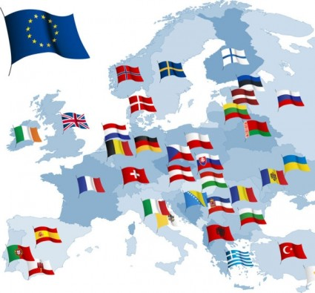
Digital by default
Open by default
Cross-border by default
Once only
Notes:
We are of course under influence from other countries and we would like to follow up and become digital, open and cross-border by default.
The once-only principle is within the public sector an aim at providing better service to people, but it also implies that we have to know when someone has collected or used some information that i now might need for my proceedings (saksbehandling) on a case.

Slide 5
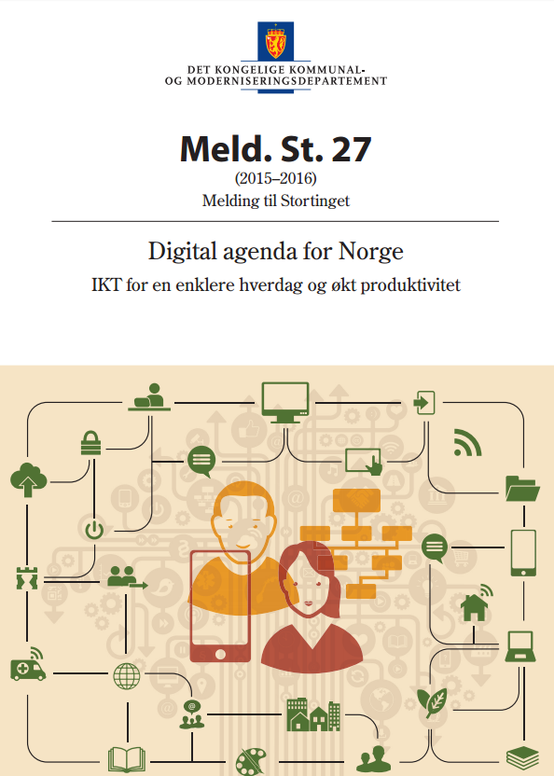
A User-centric and efficient Public Administration
Value Creation and Universal Participation
User-centric approach
Productivity and innovation
Data protection
Digital competence
Digital Single Market
Cross-sector approach
Once Only
Re-use of data
Notes:
Main goals:
Value creation and participation for all
User-centric and efficient public sector
– take away for next slide:
My main point here is that we dont usually set the agenda – we influence and adapt.

Slide 6
National Architecture
Interoperability
Alignment
Notes:
We had to follow what we could find of standardised material. This is standardised in the EU. We fasilitate the national architecture work in Norway and have invited the largest units of the public sector in a joint effort to research how norway can appliy this EU framework.
Det jobbes med en felles referansearkitektur for samhandling i EU, dette vil vi følge opp.
EIRA – referansearkitektur - en god sjekkliste for å sikre samhandling
IECart er en tjenestekatalog

Slide 7
The story…
2014 Brønnøysundregistrene and Difi joined forces to lead a project on making information an asset – visible, prioritised and anchored - in the public sector.
Public sector agencies → SKATE
Interviews, workshops → MY NEEDS → COMMON NEEDS
Solutions
And a long process to «bind them all» ☺
Notes:
The human race has alwasy been making themselves busy with interpreation and making meaning and sense out of everything. It is our main driver.
Challenge of understanding eachother - https://www.ethnologue.com/ 7,097 known living languages
Do you see the problem? I am not here to demotivate you – let me tell you the story
The beginning – a topic that started off a long time ago – with the birth of information systems.
Focus on integration – focus on web - focus on metadata – focus on semantics -
During the past 3 years, a cross sector group of public bodies has worked to establish support from a public council of directors (SKATE) and get political anchoring for a national information governance programme, based on “Once only” and EU-initiatives such as ISA.
HVOR MANGE SKATE VIRKSOMHETER/ HVOR MANGE ANDRE VIRKSOMHETER deltok i arbeidet?
Rapport fra arbeidet med informasjonsforvaltning : Fremdrift og leveranser i arbeidet har blitt samordnet med arbeidet for veikart for nasjonale felleskomponenter i regi av SKATE. Hovedleveransene inngår som en del av kunnskapsgrunnlaget for foranalysen på området informasjonsforvaltning og –utveksling som ble besluttet i SKATE 11. februar 2015.
https://www.brreg.no/wp-content/uploads/2015/12/Sluttrapport-utredning-informasjonsforvaltning-offentlig-sektor-v-1-0-2.pdf
Eierskap og ansvar
● Koordinering og metoder
● Oversikt over data
● Oversikt over tjenester
● Begrepsrammeverk
● Gjenbrukbare informasjonsmodeller
● Informasjonsutveksling
● Tjenestemodeller
● Felles referansedata
● Analysefunksjoner

Slide 8
The story continues…
A national data catalogue is currently under development
Based on a pilot at data.norge.no
A national framework for information governance is under development
Published on difi.no/informasjonsforvaltning
HIGH priority from all level of municipalities and agencies in public sector
Everyone invited to a joint network
Project: Records Management and archiving is at the stage of pre-analysis
Notes:
HVOR MANGE SKATE VIRKSOMHETER/ HVOR MANGE ANDRE VIRKSOMHETER deltok i arbeidet?
Read more on difi.no/informasjonsforvaltning
Rapport fra arbeidet med informasjonsforvaltning : Fremdrift og leveranser i arbeidet har blitt samordnet med arbeidet for veikart for nasjonale felleskomponenter i regi av SKATE. Hovedleveransene inngår som en del av kunnskapsgrunnlaget for foranalysen på området informasjonsforvaltning og –utveksling som ble besluttet i SKATE 11. februar 2015.
https://www.brreg.no/wp-content/uploads/2015/12/Sluttrapport-utredning-informasjonsforvaltning-offentlig-sektor-v-1-0-2.pdf
Eierskap og ansvar
● Koordinering og metoder
● Oversikt over data
● Oversikt over tjenester
● Begrepsrammeverk
● Gjenbrukbare informasjonsmodeller
● Informasjonsutveksling
● Tjenestemodeller
● Felles referansedata
● Analysefunksjoner

Slide 9
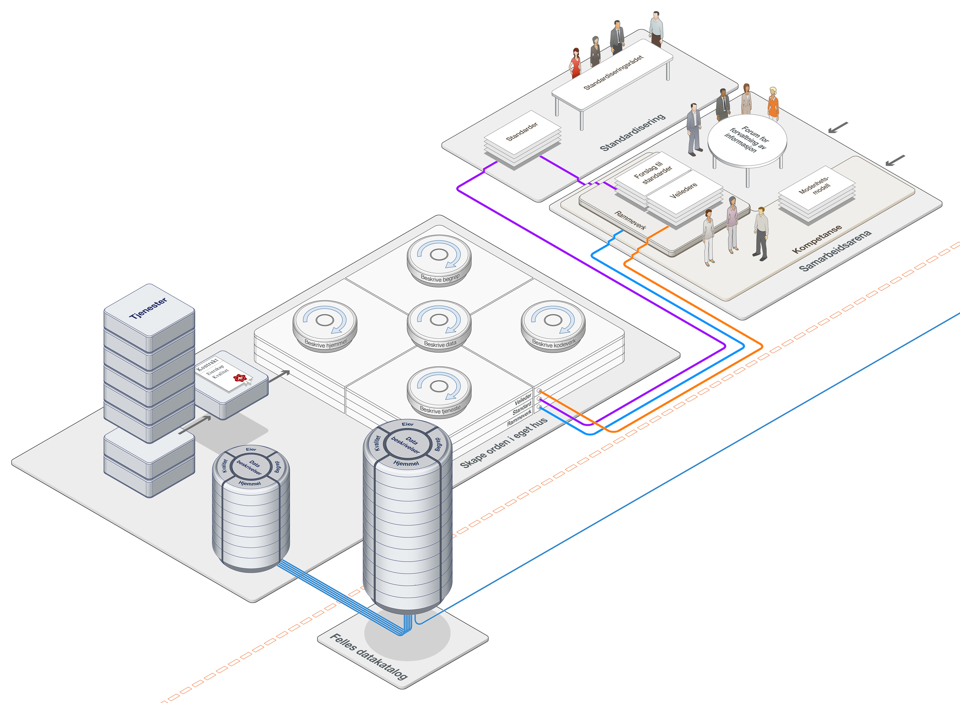
Framework
Order inhouse
Common data catalogue
Level 3 ambition
Reuse of data and services is main rule of thumb
Level 2 ambition
Data and services are accessible and available
Level 1 ambition
Common data overview exists
Foundation/framework
Common framework and steering model for public information governance
Notes:
This is our stairs of ambition.
Once only is the target state and resuse of data and services is the main rule of thumb. This requires a lot.
Digital Agenda is an ambition.
You need to have access to data and services to enable reuse by default
To have access you need to know where to og to get it. → therefore, having an overview is the first step towards the goal.
In order to have an overview in common, each and everyone needs to have an overview of their data and services.
We do not seek to identify and sort out ALL data in the overview – focus on most important to be used in exchange and collaboration with others.
The data is connected to legal matters and also to terms. Terminology is, as you all know, hard. We are not attempting a race to create all sorts of intricate ontologies, but to be able to identify if some data has restrictions to it.
Some of the stages will develop in parallell. The framework needs to be a head of technological enhancements or solutions.

Slide 10
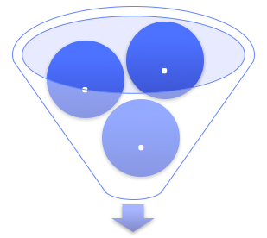
Big picture of the world of archiving
Needs and expectations
Public body
Archives
Recieve Maintain Distribute
Create
Use and govern
Prepare message to archive
transfer
Notes:
This is taken from a great presentation that I received from the Norwegian National Archives. It shows the valuechain of which archiving is a multi-stage-process where a public body prepares material for archiving – sends it over to state archives where it is archived for national historic purposes – and finally it is handed over to depot for permanent storage.
The data quality is a repeated challenging issue, it is challenging to recieve data to the archives, document it and make it ready for export and it takes a great deal of resources to make sure the archives are maintained.

Slide 11
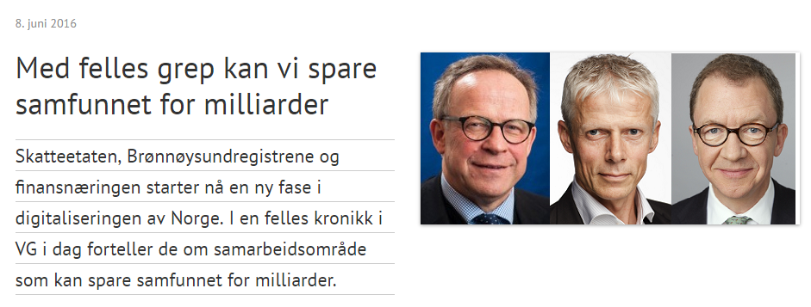
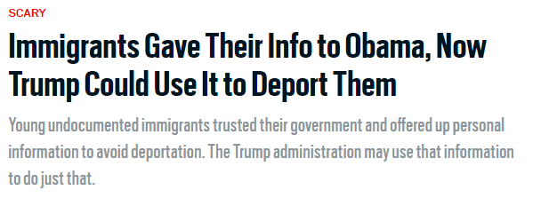
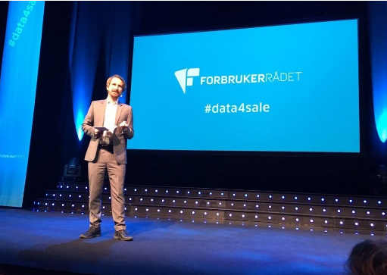
What value does information hold strategically?
Notes:
http://culturedigitally.org/2016/11/is-social-media-killing-democracy/
http://www.forbrukerradet.no/your-data-is-for-sale/
https://www.finansnorge.no/aktuelt/nyheter/2016/06/med-felles-grep-kan-vi-spare-samfunnet-for-milliarder/

Slide 12
Worth thinking about..
More business people want to use data
Citizens are invited to add value in previsouly «technical procesess»
Access and «fixes» are significantly added on a top–layer
Archiving is seen as ancient
Documents are considered dead to younger generations
Large diversity in metadatastandards and data management solutions
Weak/bad performance on data governance models
Security is crucial to data exchange (block chain as a platform?)
«Echo chambers of information»
Notes:
https://www.archives.gov/citizen-archivist
http://data.norge.no/
http://www.hack4.no/vinnerne-av-hack4no-2016
Important and interesting trends we see with regards to «dealing with» data i one form or another. The involvement of citizens for instance. The sheer amount of data is freaking us out, and data-people have not been able to convey the importance of high-quality data or to solve the collection of it for various reuse purposes.
Now, not only citizens are invited to use data to a larger degree. Several systems are made to create reports and analysis «directly» from business systems and databases and this has created a need for the business people to be closer to the data. The question is whether they understand all the work put into «the layers underneath» that is needed to facilitate high-quality and trustworthy data. I read an article [] questinoing whether we are headed to the 80’s again with silos and all kinds of cool systems – that did not talk together..
The involvement of «non-practitioners» and «non-experts» expanded and everyone were (are?) afraid that they will ruin the data and evryone is creating their own database and arguing who has the «right data».
However, some argue that «finally we have the attention of those who can make decisions concerning financing our data development.»
The echo chamber – in which some of you have already heard of – is that we are confirming our own world view again and again.
It is problematic to say the least.
If we connect it to the tasks that i think we are headed for in the future – I would say it is to make sure that a decentralised world where all views are allowed to live – but also to be communicated and shared seamlessly between systems and perspectives.

Slide 13
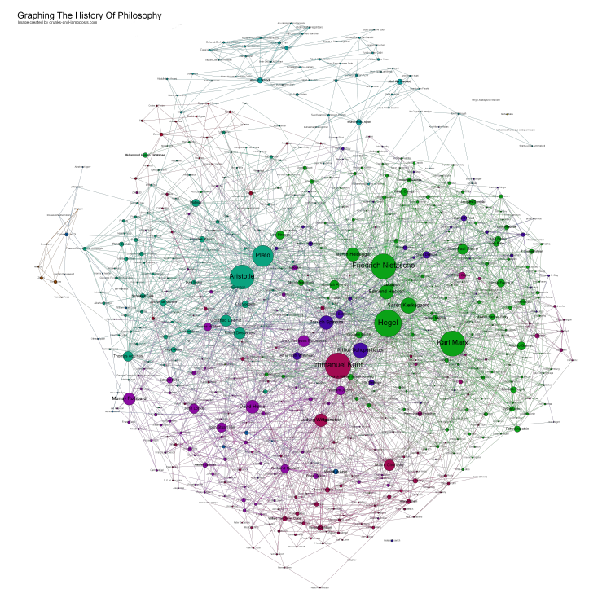
For the future – who owns the data?
Clear shift in ownership discussions
Should the citizen own their data?
Privacy as fundamental human rights
Data is BIG business
Business buy and sell your data
The public sector sells your data for services
Document or record → data and metadata
IPR and copyright
Notes:
Ownership of data is in the wind
And it is hard to keep track of it due to the introduction of the conscious graph into our economy.

Slide 14
Credits: By Tamara Harms, Illustrated by Sabine Deviche https://askabiologist.asu.edu/explore/i-spy-ecosystem
Notes:
Fundamental changes ahead
The traditional value chain thinking is not driving the economy today. We do not begin in one place and end up in a completely different one. The same goes for buyers and sellers – who is to tell anymore who is doing what?
Therefore – a predictive value chain for data is perhaps not the most sustainable thinking anymore. It is time to look into the abyss of the graph and think about how we can prepare data from the beginning to be able to be harvested in a efficient way to be captured correctly for archiving purposes.
We are talking about:
Look for the changes you cant see or predict
Ecosystems of pluralism

Slide 15
What did we learn?
Communicate in pictures
Advise – not decide
And then just do it
Include and inform
Get attention – its possible
Repeat
Be bold – show them your vision

Slide 16
Can the public sector afford NOT to use information as a strategic asset?
No, but the strategy will frame the possibilites
Need more awareness of who’s data they govern
Need for a coordinated effort on governance
Information is only a strategic asset, if acted upon NOW
URGING the communities to come together and learn to speak the same language

