Slide 1
Information Governance at the ECB: moving to automation Laura Rodewald Marie Corien Onstwedder DLM-Forum Brighton Triennial & ARMA International European Conference 2017
ECB-UNRESTRICTED
FINAL

Slide 2
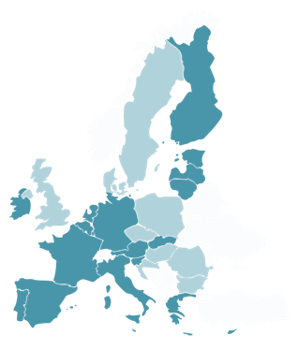
Why Information Governance at the ECB
ECB-UNRESTRICTED
FINAL
At the heart of the Eurosystem and the Single Supervisory Mechanism
1998 – Frankfurt am Main (Germany)
2002 – Introduction of the €uro
2014 – Supervisory role
Information is key to prepare decisions and perform our assigned tasks
Accountability
Transparency to the EU citizens
A knowledge organization
Compliance with EU law

Slide 3
Who we are and what we do
ECB-UNRESTRICTED
FINAL
Provide the framework for the effective governance of ECB information:
Ensure the systematic and efficient creation, management and retrieval of information throughout its lifecycle
Support collaboration and efficient access to timely and relevant information;
Ensure compliance with legal, accountability and transparency rules
Safeguard ECB’s institutional memory

Slide 4
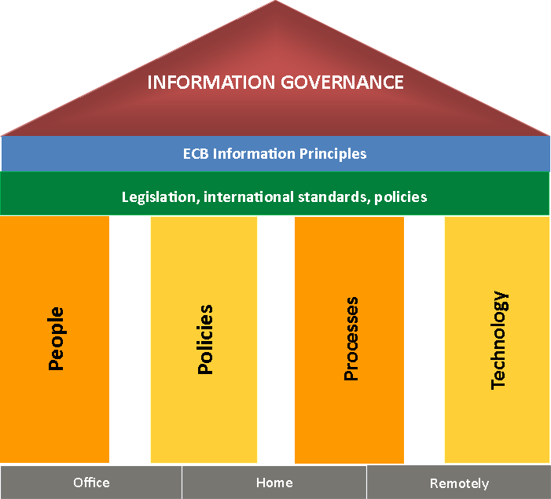
How we govern ECB information
ECB-UNRESTRICTED
ECB-UNRESTRICTED
ECB-UNRESTRICTED
FINAL
ECB Information Governance Framework
Explains how ECB information is governed
Defines the principles which guide the ECB’s desirable behaviour in creation, storage, use, management and deletion of information
Describes information environment within which ECB operates (applicable legislation, international standards and policies)
EIM Strategy
Outlines strategic direction, key strengths and challenges of Information Management
Establishes high level plan with key activities
Sets out responsibilities

Slide 5
Policies and People
ECB-UNRESTRICTED
ECB-UNRESTRICTED
FINAL
Creation
Use official ECB templates to create ECB documents and apply metadata in systems
> Author, organisation, date, status, classification…
> ECB format & design
Capture & storage
Capture all ECB documents (incl. e-mail records) in DARWIN with a meaningful name
Declare documents as records once they are final to avoid unwanted deletion or alteration and to apply retention
Send final signed documents to Archives
Distribution
Classify (5 levels) – ECB Confidentiality Regime
Share where possible, protect where necessary in line with information’s sensitivity
Always send links instead of attachments
Preservation or deletion
Keep what we need - in line with the ECB Filing & Retention Plan
Dispose of the rest - superseded documents and convenience copies securely asap
Automate retention where possible
Responsibilities
Staff member creates or receives information
Key user grants access, maintains folder structure, provides advice
Manager authorises access and distribution
IGO guides, provides support and monitoring
Training & Support
Decentralised Key Users per Business Area
Records Management Specialists & DARWIN Support for Key Users
Training for all Newcomers
Dedicated seminars, 1-2-1 training
Change management & communication
Information Governance at the ECB: moving to automation

Slide 6
Technology & Processes
ECB-UNRESTRICTED
FINAL
All electronic ECB documents must be stored in DARWIN
Original legally binding paper documents, once signed, must be sent to the Archives
Other corporate information:
Network drives, HR system, IMAS for supervisory processes, operational databases
Personal information:
Outlook for short-lived and personal e-mails
Personal drive/workspace

Slide 7
Key challenge for IG at the ECB
ECB-UNRESTRICTED
FINAL
Explosion
– of information and users!
Some numbers
+ 21,5000 users - 5,900 ECB users - 15,700 non- ECB users
+ 12 million items (e.g. documents and e-mails)
~ 300 workflows, 300 communities and 500 blogs
~ 3200 daily ECB users and 2800 daily non-ECB users

Slide 8
How to ensure sound governance of this growing amount of content and with an expanding user-base?
ECB-UNRESTRICTED
FINAL
By moving towards automation
3 cases to demonstrate this:
Project ‘Closure of network drives’
Implementation of automatic retention in DARWIN
Retention of e-mails

Slide 9
Issues and risks of using network drives
Case 1 Closure of network drives
ECB-UNRESTRICTED
FINAL
Lack of control in managing information on network drives
No version control
No relevant metadata applied
Reduced security: non-transparent access rights, no audit trail, no reconciliation procedures
Retention is not applied, e.g. information is kept longer than due
Additional time to search on multiple repositories for retrieval (e.g. public access requests)

Slide 10
Case 1 - Closure of network drives
ECB-UNRESTRICTED
ECB-UNRESTRICTED
ECB-UNRESTRICTED
ECB-UNRESTRICTED
FINAL
K:
DOCUMENTS
DATABASES
ECB documents
to be retained
DARWIN
Databases
in use
P:
New BA folders
+
Outdated remaining information
K: drive
P:
DOCUMENTS
DATABASES
P: drive

Slide 11
Case 1 - Closure of network drives
ECB-UNRESTRICTED
ECB-UNRESTRICTED
ECB-UNRESTRICTED
ECB-UNRESTRICTED
FINAL
2013
2014
2015
2016
Q4
Q1
Q2
Q3
Q4
Q1
Q2
Q3
Q4
Q1
Identify databases, programme files and econometric packages on network drives
Phase 1
Move/copy databases, programme files
and econometric packages
to new dedicated BA folder on P:
Freezing of network drives
Identify documents on network drives
to be migrated to DARWIN
Processes
Phase 2
Migrate identified documents to DARWIN
Deletion of information and decommissioning of K:
Phase 3

Slide 12
ECB Filing and Retention Plan
Case 2 - Implementation of automatic retention in DARWIN
ECB-UNRESTRICTED
FINAL
sets out how long ECB information should be kept and when it should be disposed of
Why automate retention?
Reduces manual effort - formerly was not deleted (unless users did so manually)
Ensures what needs to be kept is identified and retained to serve current and future business needs
Allows us comply with legal/regulatory requirements (e.g. data protection)
Minimises risks of legal discovery and cost of storage, retrieval and migration

Slide 13
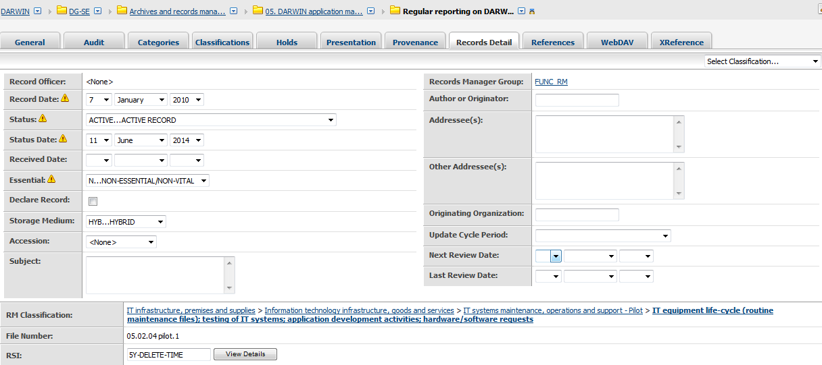
Case 2 - Implementation of automatic retention in DARWIN
ECB-UNRESTRICTED
ECB-UNRESTRICTED
ECB-UNRESTRICTED
FINAL
FINAL
How we implement automation in DARWIN
Retention actions (Record Series Identifiers – RSIs) are directly applied to business area folders in DARWIN
The system automatically performs retention activities – deletion or preservation

Slide 14
How retention works in DARWIN
Case 2 - Implementation of automatic retention in DARWIN
ECB-UNRESTRICTED
ECB-UNRESTRICTED
ECB-UNRESTRICTED
FINAL
Retention is activated upon finalization as records in DARWIN
of documents for time-based activities
ongoing activities, no clear end date, e.g. monitoring, reporting
DARWIN automatically finalizes documents after 2 years after last editing action, if they have not already been finalized in the course of business
of folders for event-based activities
activities with clear start and end date, e.g. procurement/ legal advice files/ audit missions/ IT projects, etc.
manual finalization of folders by BA staff is required
Retention is calculated from date of last version added (documents) or from date of finalisation (folders)
DARWIN destruction reports generated for approval
Evidence of destruction is kept permanently in DARWIN
Use of “holds” to temporarily exclude records from scheduled destruction (only upon request for specific procedures)

Slide 15
ECB exchange mailboxes – some facts
Case 3 - Retention of e-mails
ECB-UNRESTRICTED
ECB-UNRESTRICTED
ECB-UNRESTRICTED
FINAL
Mailboxes
Personal | 8 828
Shared | 993
Various | 966
Total | 10 787
Source | Sent | Received
Internal | 3 400 000 | ---
CoreNet | 358 000 | 200 000
Internet | 507 000 | 1 000 000
(per month)

Slide 16
Email Management: current situation
Case 3 - Retention of e-mails
ECB-UNRESTRICTED
FINAL
DARWIN
1.8 million emails (out of 12 million documents)
Retention & Protection according to ECB Filing and Retention Plan
Outlook
200 million emails stored in Exchange mailboxes
263 million emails archived in EAS
Potentially eligible in Public Access requests
Data Protection Issues
Big storage costs
No retention

Slide 17
Emails = documents
Case 3 - Retention of e-mails
ECB-UNRESTRICTED
ECB-UNRESTRICTED
ECB-UNRESTRICTED
FINAL
Business e-mails are ECB documents and should be stored in DARWIN, where considered relevant
Emails stored in DARWIN will be automatically retained or destroyed in accordance with the ECB Filing and Retention Plan
Short-lived or private e-mails should not be stored in DARWIN; they should be deleted as soon as possible after they have lost their value
E-mails remaining in Outlook will, therefore, be deleted after 12 months

Slide 18
To wrap up…
ECB-UNRESTRICTED
FINAL
Moving towards automation means:
More centralised control over document-centric processes and ECB information;
Ensuring that all ECB information is managed in a controlled environment (DARWIN) where Information Management policies are applied, controlled and monitored;
Implementing automated control on the (growing) amount of content, in particular: a way to start reducing information which has lost its value;
Reducing manual efforts in managing ECB information – making resources available for other projects.

Slide 19
ECB-UNRESTRICTED
FINAL
- THANK YOU -

Slide 20
How to reach us
ECB-UNRESTRICTED
ECB-UNRESTRICTED
FINAL
Laura Rodewald
Principal Information Management Expert
E-mail: Laura.Rodewald@ecb.europa.eu
Marie Corien Onstwedder
Senior Information Management Expert
E-mail: Marie_Corien.Onstwedder@ecb.europa.eu

