Slide 1
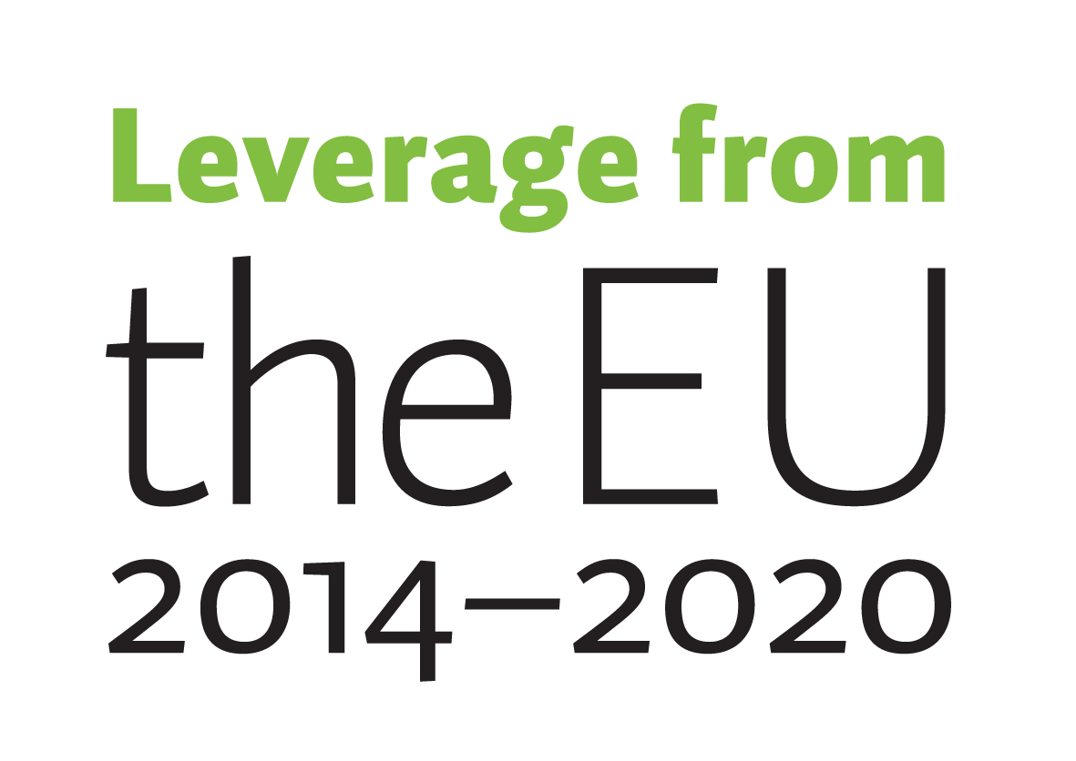
Citizen Archive as a Case Study in Personal Information Management, MyData and Personal Digital Archiving
Mikko Lampi @jotudin, Noora Talsi & Miia Kosonen @MiiaKosonen

Slide 2
Background

Slide 3
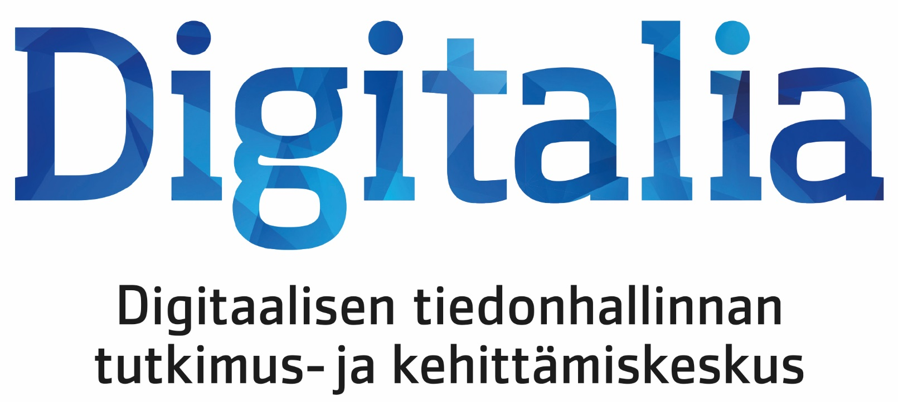
Digital archiving at Xamk
15+ years research and development
10+ years commercial services
9 years master school in information governance and digital archiving
Our current focus
Digital information management, governance and archiving
User-oriented research and usability development
Digital economy (and its technological side)

Slide 4
Key idea(s)
Digital archiving on personal and community level is more than just archiving.
We propose combining personal digital archiving, personal information management and the contemporary MyData framework.
Archiving and governance of (personal) information should consider human-centric approach,
instead of institution-centric or process-centric.

Slide 5
The big picture
Information society
Age of data (footprints and shadows)
Growth in three dimensions (volume, velocity, variety)
People are data producers and consumers
From print documents to born-digital materials and social media
How local, national and international memory is created?
Service providers
Institutional archives
Commercial cloud service providers
Do it yourself

Slide 6
The Case: Citizen Archive

Slide 7
Citizen Archive in a nutshell
The vision
Citizen Archive provides an easy to use, trustworthy and persistent open source based personal digital information archiving service for those whom cloud drives and memory sticks (etc.) are not sufficient.
Features (usually not present in just one solution)
Complete process for archiving materials
Reliable long-term preservation with professional tools
Easy to use tools and user interfaces for curation, management and use
User is the king (and makes the decisions)
High level of customization

Slide 8
Design philosophy
Technical: support for organizing and curating various types of information.
Human: user-centric approach, co-creation and meeting the needs.
Community: serving as a community memory and maintaining digital heritage over generations.
Society: empowering people, preserving personal collections outside institutional interest.

Slide 9
Technology and development
Development timeline
Open Source Archive (2012 - 2014)
Third Sector Archive (2014 - 2015)
Citizen Archive (2015 - now )
Based on open source
Micro-services, APIs and (somewhat) modular architecture
Full-text search and natural language understanding
Semantic metadata
Content agnostic
Identity and access management

Slide 10
Three approaches into personal digital archiving

Slide 11
1 // Personal archiving
How to keep our life stories safe, preserved and usable?
Why we archive
Finding stuff later
Fears of loss
Sharing resources
Building a legacy
Constructing identity
Typical materials
Documents (born digital, digitized)
Emails
Letters and diaries
Photographs and videos
Materials are collected by individuals and communities.

Slide 12
1 // Challenges
3xV of data
Value definition is hard
Digital silos and dispersion
Lack of knowledge, usable tools, and self-discipline
People vs. Archives
Archives win: curation, classification, management, processes
People win: personal value definition and value creation
Tie: decision-making

Slide 13
2 // Personal information management
We manage information all the time. There is research and evidence.
Insights into how people think and behave
We lazy and postpone decision-making → loss of data is a way to cope with accumulation
Context means a lot but can be expressed in many ways
Archives should adapt to us – not the vice versa
PIM functions should cover archiving
Benefits: provenance, availability, and trust
Is there personal information governance?
Archiving and use are not exclusive, at least from the Citizen Archive point of view.

Slide 14
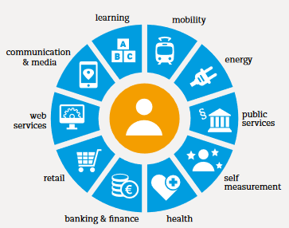
3 // MyData
Definition
A human-centric approach to personal data management and use
Personal data resource
3 principles
Human-centric control and privacy
Usable data
Open and decentralized environment

Slide 15
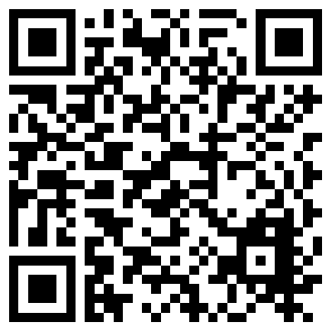
3 // MyData in practice
It’s built on the idea of consent
Auto-includes transparency and trust
Readiness for GDPR and privacy
Digital rights
Empowering people
Updating the concept of ownership
Benefits for society, business and research
Transparency, trust and digital nations
Economies of scale and better services
Contributions for research
Requirements
Machine readable
Available (pref. APIs)
Adequate metadata
Usable
From silos to interoperable resources

Slide 16
Conclusion and the next steps

Slide 17
Citizen Archive roadmap
Connect with the existing personal data services
Link with drives, storages and databases
User experience development
Better UI
Intuitive and smooth user experience
Develop a viable business model
Yes, we’d like to see Citizen Archive sustain itself

Slide 18
Discussion
What do you think, do PDA, PIM and MyData fit together?
We’d love to talk about these topics as well
Role of personal data and archives in the society, research and business
Information governance on personal and community level
Human-centric commercialization of personal data
All things MyData

Slide 19
Archives are a treasure chamber. Would you like to have a personal one?

Slide 20
Let’s talk and connect
Mikko Lampi
Research Manager Digital Economy mikko.lampi@xamk.fi | @jotudin
Noora Talsi
Research Director Digita Economy & Digitalia noora.talsi@xamk.fi
Digitalia – Research Center on Digital Information Management
https://www.xamk.fi/en/rdi/digitalia-research-center-digital-information-management/
Miia Kosonen
RDI Advisor Digitalia miia.kosonen@xamk.fi | @MiiaKosonen

