Slide 1
A Case Study: Management and Exploitation of the Nuclear Decommissioning Agency Geoscience Data Archive
Jaana Pinnick, Andrew Riddick and Garry Baker
British Geological Survey (BGS)
and
Robert McLaverty
Radioactive Waste Management (RWM)

Slide 2
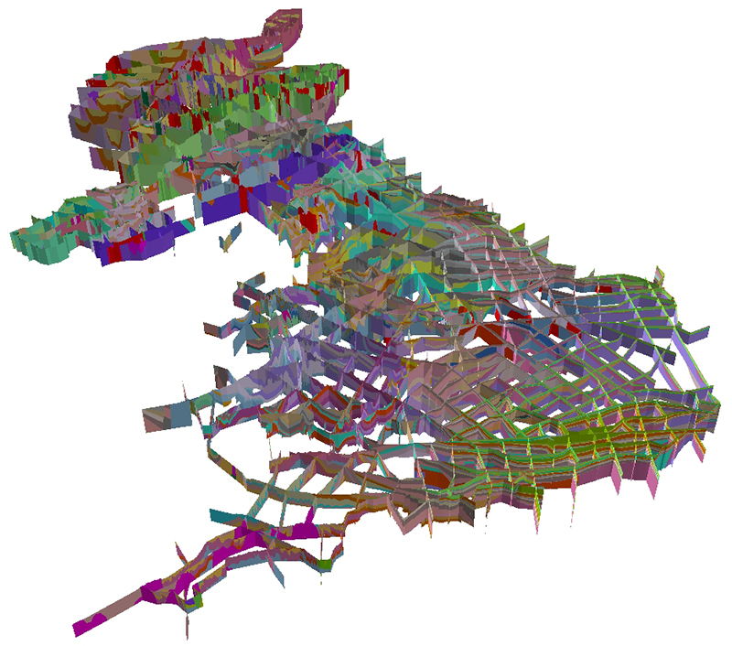
Background
An extensive geological data set collected in the 1990s/ early 2000s and stored on a variety of media
Relevant to RWM’s ongoing business operations over many decades into the future
Important data source for geoscience research community
Observations difficult and expensive to repeat
Some of the data formats challenging or impossible to read in modern software
Supporting information limited and inconsistent

Slide 3
Early Days (1997-2000)
Geoscience data captured by a variety of organisations and consultancies
Magnetic tape archive, Nirex Digital Geological Database (NDGD), and 3-D models
Integrated NDGD database created with a view of preserving the data and maintaining future access (20+ years)
Data in Oracle© and GIS systems exported as standardised data/ text files (.dat, .csv, .txt)
A hard copy print out of the data taken as the final data rescue option

Slide 4
Previous preservation actions
Data Archive transferred to BGS in 2000
Critical datasets rebuilt from export files onto the BGS corporate Oracle©
Remaining data first copied onto DLT (Digital Linear Tape) and then on to corporately maintained storage area network (SAN)
Duplicate copies of the data held on DLTs stored as an off-site backup
Documentation of the formal status of the data within the archive created to facilitate future understanding of data, formats, volumes, sources, and locations

Slide 5
Initial findings
The archive has been stored using the 3-2-1 backup strategy (three independent copies) – one on the SAN, another on tape, and a third copy in a geographically separate location
Information on past preservation events captured but not systematically documented
Need to develop and populate a preservation metadata element
Fixity checks, which would show any changes within the data files, were not made initially

Slide 6
Approach and methodology
Current data rescue project started in 2014 with several aims:
To standardise metadata assembled by differing consultants
To create a unified digital index
To create high-resolution digital images of the slides
To use DROID tool and PRONOM file registry to create a file profile of the whole archive
To assess risks and identify mitigation methods
To analyse requirements for a preservation metadata schema

Slide 7
File format profiling
74 file types recognised by DROID, 280 were not
Four file extensions (72% of recognised formats) include 26,000 out of 36,500 files: .txt, .csv, .tif and .sgy
160 file types (13,000+ files) transformed into .txt files early on to ensure the preservation content – but compromising on functionality (SA1806.AVG.TXT, BA1108_1.IN.TXT, or MAG4.DAT.TXT)
Some file extensions manually altered as part of the original data management processes of the source consultancy

Slide 8
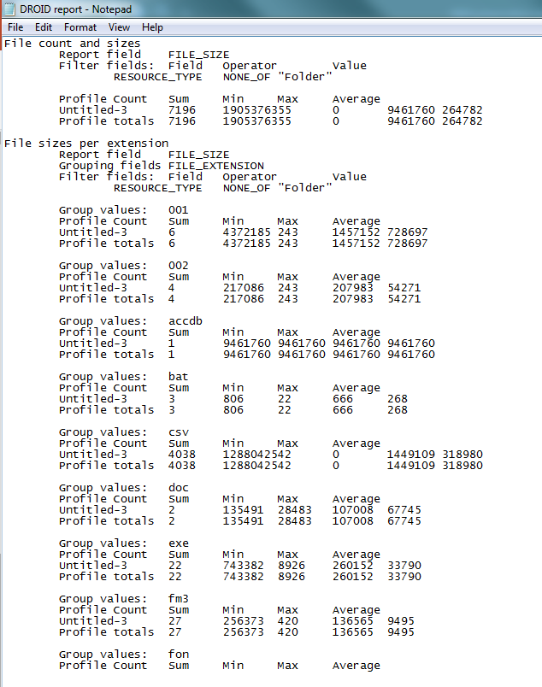
DROID reports

Slide 9
Spreadsheets
PUID | Version | Total file count
fmt/56 | MS Excel 3.0 | 386
fmt/59 | MS Excel 5.0/95 | 137
fmt/214 | MS Excel 2007 onwards | 58
fmt/61 | MS Excel 97 (8) | 15
fmt/172 | MS Excel for Macintosh 3 | 3
fmt/173 | MS Excel for Macintosh 4 | 3
fmt/174 | MS Excel for Macintosh 98 | 3
fmt/175 | MS Excel for Macintosh 2001 | 3
fmt/176 | MS Excel for Macintosh 2002 | 3
fmt/177 | MS Excel for Macintosh 2004 | 3
fmt/178 | MS Excel for Macintosh X | 3
fmt/60 | MS Excel 95 (7) | 3
fmt/57 | MS Excel 4.0 (4S) | 1
x-fmt/117 | Lotus 1 | 2
x-fmt/114 | Lotus 2 | 83
x-fmt/115 | Lotus 3 | 112
x-fmt/116 | Lotus 4-5 | 4

Slide 10
Files not identified by DROID - file type deduced
280 file formats not identified
For 200 individual formats, the source software inferred from the location of the data
Mainly Vulcan, Earth Vision and Bentley MicroStation 5.0 data files
Existing Readme notes provided additional information on software versions, naming conventions and directory structure
78 files without a file extension – same logic applied

Slide 11
Partially readable files
~3,500 files of salinity mapping data where the file header could be read using a text editor, providing limited metadata
Data outside the header was scrambled and currently unreadable (e.g. FC6, .SOR and .M91)
Still possible to contact individuals who worked on this data 20 years ago to obtain more information on the data types

Slide 12
Header metadata, unreadable data

Slide 13
Files unidentified by DROID
80 unidentified formats ~4,000+ individual files (e.g. .mtx, .sta, .his)
Extracted from one of the DLTs - data concentrated on one particular area in the file directory, making it a localised issue
Small volumes of unidentified files dispersed elsewhere in the archive
Able to read some of these

Slide 14
Unreadable data files
Not a big problem at this stage

Slide 15
Preservation metadata
Integration and capture of minimal preservation metadata suggested, using an agreed PREMIS metadata schema complemented with tailored local information
Populating preservation metadata fields with existing information where available
Inclusion of fixity checks (using DROID or another tool) and checking these at regular intervals in the future to assess and maintain data integrity

Slide 16
Sample of a PREMIS scheme
OBJECT objectIdentifier
preservationLevel
significantProperties
objectCharacteristics
fixity
size
format
creatingApplication
storage
EVENT eventIdentifier
eventType
eventDateTime
eventDetailInformation

Slide 17
Risk analysis
SPOT methodology a starting point for requirements analysis for digital preservation metadata
Focus on availability, identity, persistence, renderability, understandability and authenticity
PREMIS 3.0 metadata dictionary investigated
A risk matrix created which includes a description of each identified risk, aligning them with appropriate PREMIS entities
Prioritises risks and suggests mitigation methods

Slide 18
Risk Matrix

Slide 19
Conclusions
File profiling analysis provides a useful collection of metadata on which to base further preservation work
Further prioritisation/ risk assessment exercise required to assess the science and business value of the data
Use of the risk matrix to inform the development of a tailored preservation metadata schema
Integration of available and future preservation metadata into a PREMIS-based schema, to be held in a relational database

Slide 20
Lessons learned
Consider your preservation strategies early on
Create Readme notes with additional information to describe the data as early as possible
Recommend a list of preferred/ open file formats and comply with it
Back the up data using the 3-2-1 method
Run fixity checks at ingestion and repeat at regular intervals, replacing corrupt data from other copies
Include metadata fields to capture preservation events and populate them from the outset
Monitor your data regularly!

Slide 21
Questions?
Jaana Pinnick, BGS
jpak@bgs.ac.uk
Twitter @NottsFinn

