Slide 1
Blockchain case study: Estonia
8th Triennial International DLM Forum Conference
Brighton, 14.09.2017

Slide 2
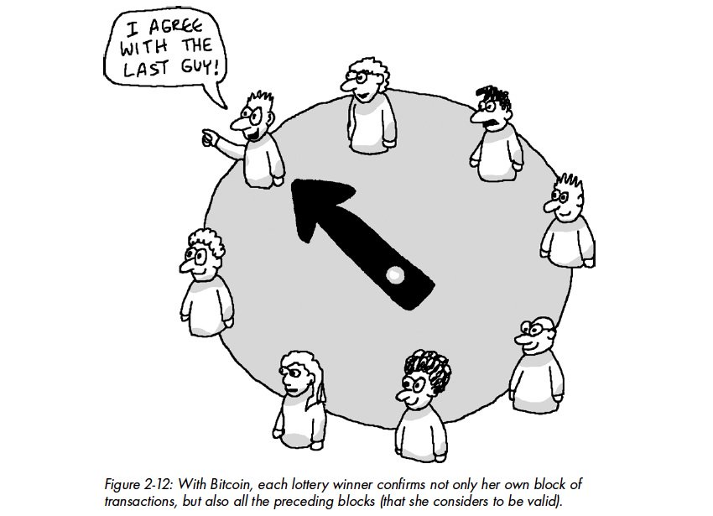
Background
Increasing blockchain interest by data creators
Including data of archival value
Need for archives to understand blockchain technology and how it affects data preservability
Bonus: is blockchain also applicable in digital preservation?

Slide 3
Situation in Estonia
Widely digitised public sector processes
Thousands of crucial public services online, many delivered digital-only
About 15-20 major public sector datasets have implemented blockchain solutions over the last 3-4 years

Slide 4
Case study
Carried out by NAE and Victoria Lemieux (UBC)
Two public sector data providers with six information systems
e-Health Foundation (e-Health Information System)
Ministry of Justice Centre of Information Systems (five separate information systems)
Technology provider (GuardTime)
Private blockchain provider, used by all the above
Policy layer (Ministry of Economic Affairs and Communication)
Private sector use case (FunderBeam)
ChromaWay platform (SE)

Slide 5
e-Health
Central access point for all high-level medical information (visits, surgeries, analyses, etc.)
Highly sensitive data
National IT security regulations mandate the use of hash chains for data integrity
Implemented since mid-2000s
Use of blockchain since 2016
Scalability concerns: daily about 40,000 documents (XML and PDF representations) are added to and 1,000,000 transactions are logged in the system
NB! All documents are already signed using the Estonian digital signature

Slide 6
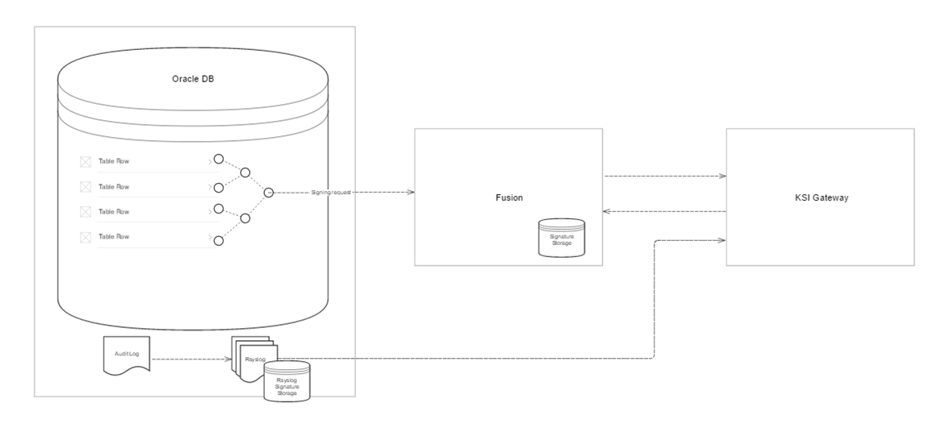
e-Health: blockchain usage

Slide 7
Centre of Information Systems
Blockchain used for:
Successions Register
e-Land Register
e-Business Register
e-File
Publications Office
All of these systems are required to have „high“ or „very high“ measures implemented in regard to data integrity

Slide 8
Centre of Information Systems
Blockchain in production use since 2014 – 2015
Guarding data and most crucial bits of metadata (i.e. database rows)
Creation of an internal hash chain for each record (all computer files + metadata)
The top of the hash chain is sent to blockchain
Effectively one blockchain entry for each record
Practical need to alter records or link consecutive records
Input error correction, updated wills (succession register) etc.
No biggie technically
create a new record, mark the previous as „obsolete“
Need for controlled deletion (RM and system load issues)!
Interest for native „blockchain provenance“!

Slide 9
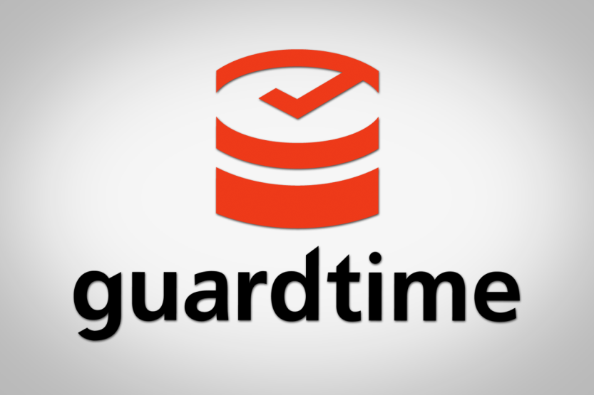
The technology
Company: GuardTime
Private (permissioned) blockchain
Available as
service – all nodes maintained by GuardTime, or
platform – set up your own node network
Focus on scalability
Uses of mathematical consensus mechanisms

Slide 10
Selected statements
Blockchain seen as an „additional security layer“ on top of more traditional hash sums and digital signatures – „advanced hashing“
Role of blockchain is to maintain and check the integrity of data – „just another mathematical method“
External blockchain network allows for third-party verification
protection against „sysadmin running loose“
Blockchain as a „trust-technology“
Trust as such is a moving target – „We used hashes, then digital signatures, now there’s blockchain. Probably there’ll be something new (and better) in a few years.“

Slide 11
Blockchain issues
What is blockchain anyway?
Privacy concerns
Scale and cost
Blockchain longevity
Provenance

Slide 12
Conclusions
Blockchain is here to stay
Offering an excellent method for proving the integrity of data
To be seen as just one component in the bigger picture (for now)
Need to consider privacy and scale
Data provenance, identity and (partially) authenticity need to be dealt with separately
.. but need to look out for more advanced scenarios (f.ex. smart contracts)

Slide 13
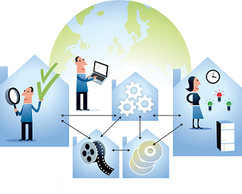
Blockchain in digital preservation
Two most potential application areas:
Storing IPs
To replace or extend traditional hash sums, digital signatures and similar
Preservation metadata
To prove the integrity of preservation actions (esp. migration)
Additional security layer in case of off-line storage or platform migration

