Slide 1
Archives and Data Lakes
Can two become one?
13th September 2017
i-squared consulting www.thei2hub.com

Slide 2
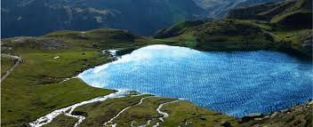
Perception is everything
Notes:
Archives:
Old-school technology
Huge volumes of data which difficult to manage
Represent cost and risk and little business value
Data lakes:
New, exciting technology
Opportunity to exploit value from data and drive business strategy

Slide 3
Definitions
Gartner defines 3 types of archives:
Compliance Archives containing data required to meet regulatory or audit requirements;
Historical Archives that contain the older, very infrequently accessed business records;
Analytics Archives containing data that may need to be regularly accessed or used for reporting purposes
A data lake is a storage repository that holds a vast amount of raw data in its native format, including structured, semi-structured, and unstructured data. The data structure and requirements are not defined until the data is needed.

Slide 4
Requirements
Archive | Data Lake
Records capture and classification | Storage of large volumes of data in native format
Data retention and disposal | Data ingestion from multiple sources and in multiple formats
Access and security management | Data ingestion in real or near real time
Search, hold, and retrieval | Access and security management.
Audit and reporting | Mining, analysis and reporting

Slide 5
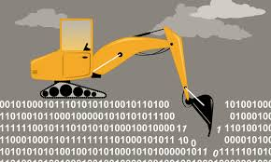
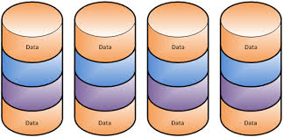
Use cases
Notes:
Pre-defined vs Data-mining
Historical vs real time
Data volumes

Slide 6
Architectural View
Notes:
Conceptual architecture illustrating the similarities and differences between Archives and Data Lakes.
Many organisations have multiple archives, not necessarily based on the Gartner definition, rather on the type of data. In large Financial Services organisations for example, there will often be one (or more) archives for email and chat messages, another for voice recordings, strucutred and unstructured
multiple archives is often a legacy issue where technology was only suitable for one data type which has then perpetuated silos. This has meant management of several archiving technologies as well as the need to search against and retrieve from multiple repositories for discovery purposes. In part due to this, as well as the desire to improve exploitation of data, the idea of a unified archive is very appealing

Slide 7
In our experience
Legacy archives are complex and problematic, often not meeting compliance requirements
IT leaders are focused on new, exciting technology and want to exploit big data initiatives
Senior management don’t understand why data lakes can’t solve for compliance and e-discovery – why keep everything twice?
Information governance is not well understood, yet is critical for both data lakes and archives

Slide 8
Information Governance
How to identify PII to meet GDPR
Ensure record been accurately and immutably captured
Identify golden sources
Trace data quality and lineage

Slide 9
And finally …
Notes:
Data lakes and archives are two different storage approaches that often draw on the same data but support different use cases. There are some commonalities, such as the need for governance, search and analysis. There are also differences, such as volume, format, classification and length of retention. Currently, the compliance requirements on archives stand at odds with the flexibility for innovation that data lakes exist to achieve and thus trying to merge the two may lead to unacceptable functional or performance compromises.
However, with data lakes maturing and the rapid advances in technology, it is very likely that over time even these conflicting requirements will not stand in the way of two becoming one. The evolution of cloud technology, with low cost storage and on-demand processing power is a significant contributor to the future opportunities.

Slide 10
Contact us
Nina Bryant, Managing Director
Mob: +44 (0)7828 794488
Tel: +44 (0)1793 393696
email: nina.bryant@thei2hub.com
www.thei2hub.com

